Slide 1
International Standards for Usability

Slide 2
Introduction
International standards are well known for specifying standards for hardware and software
Over the last 15 years, a comprehensive range of international standards has been developed to define the general principles of user centered design and good practice in user interface design.
Most of the standards specify general principles rather than the precise details of the interfaces how they should be developed or look.

Slide 3
Need for Standards
With the considerable growth of Internet/Web applications and keeping their distributed nature in mind, it is to be noted that the developers, technical staff and training instructors have no direct access with the end user . Users now a days are spread over the globe..
Software Usability is no longer a luxury, but rather a basic determinant of productivity and acceptance.
Software industry and Government will become more productive if they take advantage of usability engineering techniques.

Slide 4
Need for Standards
These standards are developed under
ISO ( International Organization for Standardization)
&
IEC (International Electro technical Commission).

Slide 5
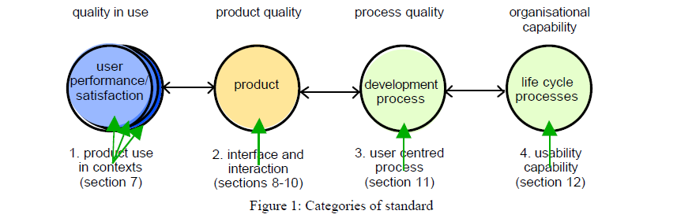
Types of standard for Usability
Standards related to usability are categorized into:
The use of the product (effectiveness, efficiency and satisfaction in a particular context of use)
The user interface and interaction
The process used to develop the product
The capability of an organisation to apply user centred design.

Slide 6
Types of standard for Usability
The ISO has developed different standards on usability and two major categories :
Product-oriented standards (ISO 9126 and ISO 14598)
Process oriented standards (ISO 9241 and ISO 13407)
Here in these systems usability is defined from a different view point :: from end user point of view, from managers, developers etc.
This diversity of view point and their related usability requirements have led to different perspectives on usability in the various ISO models that have been developed over the years by different groups of usability experts.
And each group has built its model without input from others leading into the use of different terms and labels for the same usable characteristics or different terms for similar characteristics… without full consistency across these models.

Slide 7
Usability Definitions
“The capability of the software product to be understood, learned, used and attractive to the user, when used under specified conditions.” (ISO/IEC 9126-1, 2000)
“The extent to which a product can be used by specified users to achieve specified goals with effectiveness, efficiency and satisfaction in a specified context of use.” (ISO 9241-11, 1998)
“The ease with which a user can learn to operate, prepare inputs for, and interpret outputs of a system or component.” (IEEE Std.610.12-1990)

Slide 8
Standards described
ISO Title | Description
ISO nnnn (date) | A standartd number nnnnpublished on date, developed by an ISO committee.
ISO nnnn-xx(date) | Part xx of a standard developed by an ISO committee.
ISO/IEC nnnn (date) | A standard developed by JTCI: A joint technical committee of ISO and IEC.
ISO TS nnnn (date) | An ISO technical specification : a normative document that may later be revised and published as a standard.
ISO TR nnnn (date) | An ISO Technical Report : an informative document
ISO ZZ nnnn (date) | A draft standard of document type ZZ made available on date.

Slide 9
Standards described
Stage | Document Type |  | Description
1 | AWI | Approved Work Item | Prior to a working draft
2 | WD | Working draft | Preliminary draft for discussion by working group
3 | CD CD TR or TS | Committee Draft Technical Report/Specification | Complete draft for vote and technical comment by national bodies
4 | CDV DIS FCD DTR | Committee Draft for Vote Draft International standard Final Committee Draft Draft Technical Report/Specification | Final draft for vote and editorial comment by national bodies
5 | FDIS | Final draft International Standard | Intended text for publication for final Approval
6 | ISO ISO TR or TS | International Standard Technical Report or Technical Specifications | Published Document

Slide 10
Standards dealing with product usage (product use in context) characteristics
ISO 9241-11 (1998) Guidance on Usability : explains how to identify the information that it is necessary to take into account when specifying or evaluating usability in terms of measures of user performance and satisfaction.

Slide 11
ISO 9241-11 (1998) Guidance on Usability
General
Material Requirements
Environment
Software
General Introduction
&
Guidance on task requirements
Environmental Requirements
Dialogue principles,
Usability specifications measures,
Information presentation,
User Guidance,
Menu dialogues,
Command dialogues,
Direct Manipulation dialogues,
Form filling dialogues
Visual display,
Keyboard
Workstation layout and postural ,
Display with reflections
Displayed colors, Non-keyboard input devices

Slide 12
Standards dealing with product interface attributes
ISO 9241-1 (1997) Ergonomic requirements for office work with visual display terminals (VDTs)
ISO 9241-2 (1992) Guidance on task requirements
ISO 9241-3 (1993) Visual display requirements
ISO 9241-4 (1998) Keyboard requirements
ISO 9241-5 (1998) Workstation layout and postural requirements
ISO 9241-6 (1999) Environmental requirements
ISO 9241-7 (1998) Display requirements with reflections
ISO 9241-8 (1997) Requirements for displayed colours
ISO 9241-9 (2000) Requirements for non-keyboard input devices

Slide 13
Standards dealing with product interface attributes
ISO 9241-110 (2006) Dialogue principles [previously ISO 9241-10 (1996)]
ISO 9241-12 (1998) Presentation of information
ISO 9241-13 (1998) User guidance
ISO 9241-14 (1997) Menu dialogues
ISO 9241-15 (1998) Command language dialogues
ISO 9241-16 (1999) Direct manipulation dialogues
ISO 9241-17 (1998) Form-filling dialogues
ISO 9241-151 (2008) Guidance on World Wide Web user interfaces
ISO 9241-171 (2008) Guidance on software accessibility

Slide 14
Standards dealing with product development process
ISO 9241-210 (2010) Human-centred design for interactive systems [previously ISO 13407 (1999)]
This standard provides guidance on human-centred design activities throughout the development life cycle of interactive computer-based systems.
Human-centred design is described as a multidisciplinary activity, incorporating human factors and ergonomics knowledge and techniques with the objective of enhancing effectiveness and efficiency, improving human working conditions, and counteracting possible adverse effects of use on human health, safety and performance.

Slide 15
Standards dealing with product development process
ISO 9241 has the following advantages::
1. The ISO 9241-11 model identifies usability aspects and context-of-use components to be taken into consideration during specification, design and usability evaluation;
2. User performance and satisfaction provide direct measurements of usability in a particular context;
3. User performance and satisfaction measurements provide a basis for comparing usability with other design features for the same context;
4. Usability can be defined and verified within quality systems conforming to ISO 9001.

Slide 16
Standards dealing with product development process
ISO 9241 has weaknesses also:
1. It addresses usability strictly from a process perspective, hence tackling only a single viewpoint;
2. ISO 9241-11 does not tackle the learnability characteristic as it is recommended by the majority of standards and experts on usability;
3. It does not tackle the security aspects, considered to be very significant by domain experts.

Slide 17
Standards dealing with product interface attributes
ISO/IEC 9126-1 (2001) Software Engineering - Product quality - Part 1: Quality model -- This deals with quality aspects and specifies a two-part model for software product quality:
a) Internal quality divided into six characteristics: functionality, reliability, efficiency, usability, maintainability and portability. External quality is manifested when the software is used as a part of a computer system, and is the result of internal software attributes.
b) Quality in use characteristics: effectiveness, productivity, safety and satisfaction. Quality in use is the combined effect for the user of the six software product quality characteristics

Slide 18
Standards dealing with product interface attributes
ISO/IEC 9126-1 (2001) Software Engineering - Product quality - Part 1: Quality model --
External and internal Quality
Functionality
Reliability
Usability
Efficiency
Maintainability
Portability
Suitability
Accuracy
Interopera-bility
Security
Functionality
Compliance
Maturity
Fault – Tolerance
Recovera-bility
Reliability
Compliance
Understand-ability
Learnability
Operability
Attractive-ness
Useful
compliance
Time behavior
Resource utilization
Efficient
Compliance
Analyzability
Changeability
Stability
Testability
Maintain-ability
Compliance
Adaptability
Instability
Co-existence
Replaca-bility
Compliance

Slide 19
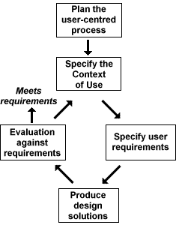
Standards dealing with product development process

Slide 20
Standards dealing with process description (Human-centered lifecycle process description)
ISO TR 18529 (2000) Ergonomics of human-system interaction
This Technical Report contains a structured and formalised definition of the human-centred processes described in ISO 13407:
HCD.1 Ensure HCD content in system strategy
HCD.2 Plan and manage the HCD process
HCD.3 Specify the user and organisational requirements
HCD.4 Understand and specify the context of use
HCD.5 Produce design solutions
HCD.6 Evaluate designs against requirements
HCD.7 Introduce and operate the system

Slide 21
The Usability Maturity Model
The Usability Maturity Model in ISO TR 18529 can be used in conjunction with ISO 15504 Software process assessment to assess the capability of an organization to carry out user-centred design by rating each HCD process on the scale: Incomplete, Performed, Managed, Established, Predictable and Optimizing.

Slide 22
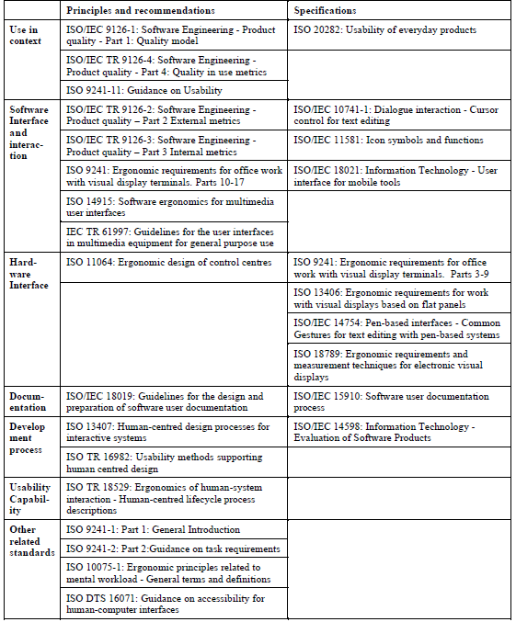
Standards described

Slide 23
CONCLUSIONS
The majority of effort in ergonomics standards has gone into developing conditional guidelines.
It provide an authoritative source of reference, but designers without usability experience have great difficulty applying these types of guidelines.
Several checklists have been prepared to help assess conformance of software to the main principles in ISO.
There are weakness at the level of defining international standards as the development process is slow, and the content depends on the voluntary effort of appropriate experts

